Slide 1

DriverPass System Analysis
Ryan Stork
Notes:
[No speaker notes required for this slide.]

Slide 2

System Requirements
Functional Requirements
The system will allow the user to purchase different packages
The system shall pair a customer with a driver
Non-Functional Requirements
The System Needs to be able to run on all major web browsers. I.e., Chrome, FireFox, Edge and Safari
Since the system is cloud-based, we need to rent servers from a provider, like AWS.
Notes:
I would like to begin by talking about some functional and non-functional requirements needed for this system. The complete list of these can be found in the Business Requirements document that I have passed around. I wanted to speak about a few of, what I feel, the most important requirements. One of the functional requirements is that the system will allow a customer to purchase different available packages. When purchased, this will allow the customer the ability schedule driving lessons. Which brings us to the second functional requirement, that after a package is purchased, the system will pair the customer with a driver. Once they have a driver, they will be able to schedule an appointment with that driver. This meets the needs of
There are important non-functional requirements for our system as well. This system is supposed to be web-based, so we need to make sure that it is fully functional on all major web browsers. This would include Chrome, Firefox, Edge and Safari. And to allow the ability for a customer or employee to access the system from anywhere, this system needs to be on the cloud. DriverPass requested that they wanted as little maintenance as possible, so we would need to rent from a cloud provider, like AWS

Slide 3
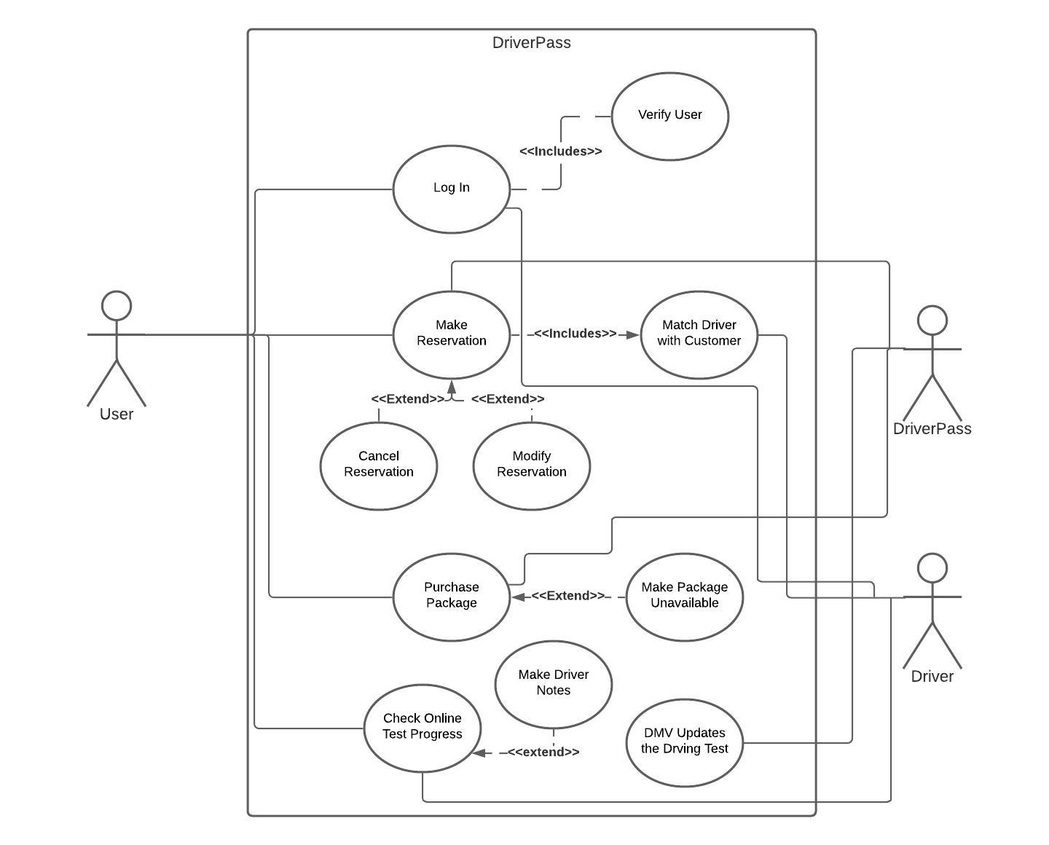
Use Case Diagram
[Insert your use case diagram here.]
Notes:
This is a basic Use Case Diagram. We have 3 main users this system. The customer is the user on the left. The employee is DriverPass on the right, and there is also the Driver on the right.
The user will be able to log in, purchase a package, make a reservation and check online test progress. When a reservation is made, the system will make a driver with the customer. The user also has the ability to cancel or modify the reservation.
The Driver has the ability to log in, then he can check the reservations to see who he is assigned to. Once a driver has completed a drive, he has the ability to add notes to the customers online test progress page.
The DriverPass has the ability to make a reservation for a customer. They can also cancel or modify those reservations. The owner, also under DriverPass will have the ability to make the packages unavailable.

Slide 4
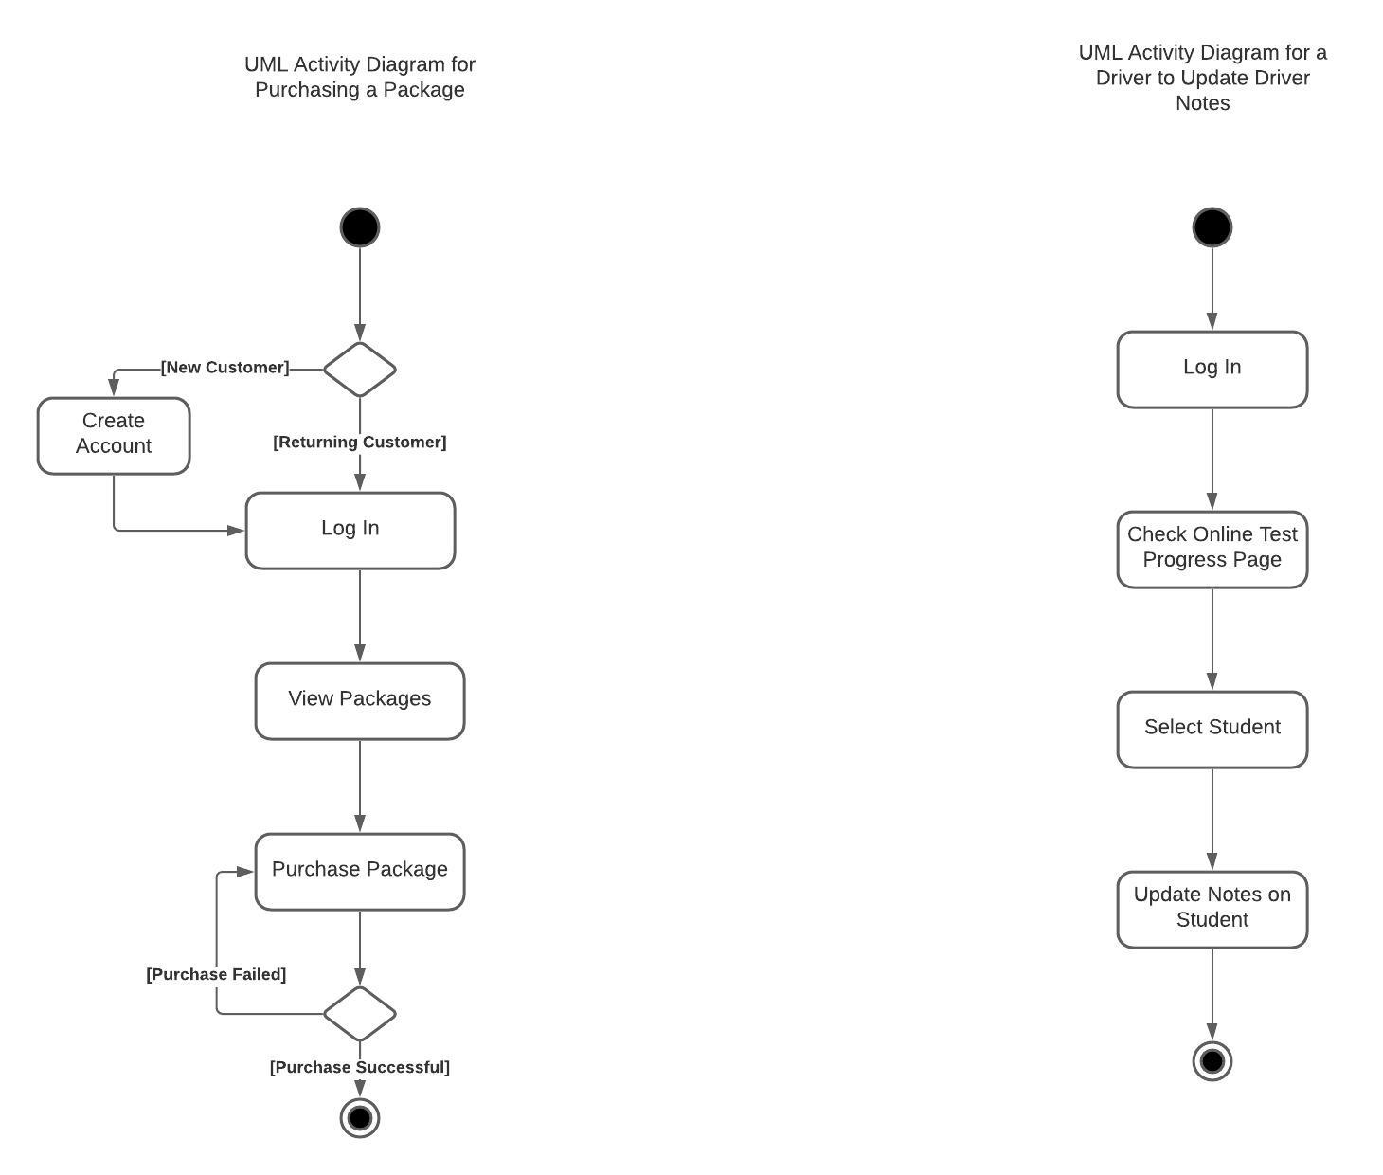
Activity Diagram
[Insert one of your activity diagrams here.]
Notes:
These are two of the most likely uses for DriverPass that I have broken down in an activity Diagram. With the activity on the left, the customer will load up the DriverPass page. If they are a new customer, they will create an account then log in. If they are a returning customer, they will just log in. The customer will view the packages. Then purchase a package. If the payment is accepted, this is the end of the activity, but if the payment is declined, they will stay at the purchase package screen until a transaction is approved.
The Activity on the right is when a driver wants to update the notes on the student. Notice, that a driver will not need to register an account as one would be assigned to him by DriverPass. The driver will log in, then they will go to the Online Test Progress Page. He will select the student, then he will update the notes for that student. This would save the information on the DriverPass system so the notes could be viewed by the customer.

Slide 5
Security
For the user to log in you would be required a username and password. The username would be an email address.
The password would be sent to the server as a hash of the user input. In our database, we would only have a copy of the hash, not the actual password. Then we would check if the passwords match.
If 3 incorrect inputs are entered, then they would have to change their password after they are asked a security question. If the security question is answered correctly, then the user can put in for a new password. The same would happen if the user forgets their password.
If the user is an employee, they would also have to log in with two-factor authentication. This would be done with an authenticator like Google Authenticator. This would prevent unauthorized entry on employee accounts.
Notes:
Security is very important both to DriverPass and to the customers. The security would start with the log in and password. I would recommend the username be an email address, this way we can verify the user by sending an email to the email address provided. We would not store the password on the server, but we would have an encrypted version of the password. If the system was compromised, we would not have the actual password for the user.
If multiple attempts of the password were put in incorrectly, we would have security questions that a user would answer to verify identity. If the user changes the password, we will keep the updated encrypted password with our system. I would also recommend that employees use two-factor authentication. This can be done with an authenticator like Google Authenticator. Every 60 seconds a six-digit number is changed on that app. The user would have to enter in that code to gain entry to the system.

Slide 6
System Limitations
There would be limitations with initial packages. We do not know what users will want. We should be able to add or delete packages as needed.
More time should be given to develop the interface to make sure that it will work on multiple platforms simultaneously.
We are limited on technology by the current systems that are available to us.
Notes:
There are limitations to the system. The first limitation is with the packages. When we launch, we will have three initial packages. The owner will be able to disable those packages as they see fit. With future updates, we will be able to add or delete packages.
We can only work with one system at a time for a user, we need more time to allow the user to use their credentials with a PC and mobile device simultaneously.
Our technology is limited to what is available to us right now. As new technology becomes available at a reasonable price, DriverPass may add these new functions.

